Slide 1
Diocesan NFP Ministry
Best Practices:
A Look at Requiring NFP Education
as Part of Marriage Preparation
Rev. Robert Cannon, JCL
Rachelle Sauvageau, Diocese of Fargo
Cindy Leonard, Diocese of Phoenix
Notes:
(Speaker click and read 4x)
(ck next)
{{ Slide 1 }}

Slide 2
Diocesan NFP Ministry
Best Practices:
A Look at Requiring NFP Education
as Part of Marriage Preparation
Canon Law
Goal & Strategy
Consultation
Implementation
Results
Notes:
(Speaker click and read 4x)
(ck next)
{{ Slide 1 }}

Slide 3
Rev. Robert Cannon, JCL
Canon Law

Slide 4
Stage One- Creating an NFP Requirement for Marriage Prep (Goal & Strategy)
Some Preliminary Considerations:
What is your Bishop’s/ Diocese’s goal?
What is your current policy?
What changes need to be made to meet the goal?
What are the limiting factors for your diocese?
Are there enough NFP teachers?
Who is overseeing this project?
What is your team?
What is your strategy and timeline?
Are there exceptions to the policy?
Stage 1
Notes:
Rachelle and Cindy—you two will present how the strategy was created for your requirement of NFP classes as part of marriage preparation. Give a description of how the current policy is implemented in your diocese. You should also be prepared to present what you know of how couples respond to this requirement and continue to accept and use NFP in their marriages. You may be asked questions about priest reaction to this policy as well.
Rachelle and Cindy—you two will present how the strategy was created for your requirement of NFP classes as part of marriage preparation. Give a description of how the current policy is implemented in your diocese. You should also be prepared to present what you know of how couples respond to this requirement and continue to accept and use NFP in their marriages. You may be asked questions about priest reaction to this policy as well.

Slide 5
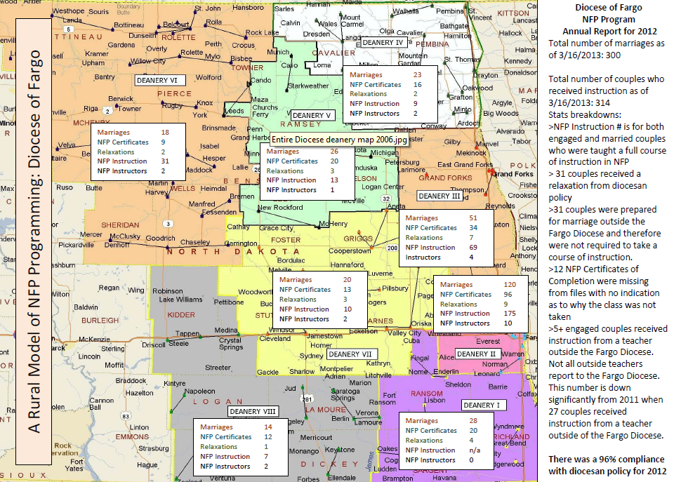
Diocese of Fargo
NFP Program
Annual Report for 2012
Stage 1

Slide 6
Diocese of Phoenix: 1998-2009 changes to marriage prep policy
1998 Policy
Some analysis of current issues, explanation of God’s plan and Pastoral response to crisis
Parish/Diocesan programs encouraged
Basic trainings for MPM’s and MPL’s
Two courses required (approx. 14 hrs.)
Introduction to Natural Family Planning
Cost of Preparation: $140-300
(Dioc. schol. available)
7. Six-month prep period
2009-10 Policy
Analysis, diagnosis, theological understanding, pastoral response deepened
Parish/Diocesan/Online programs encouraged
More thorough training
Three courses required (approx. 26 hrs)
Full course in an approved method of NFP – At least 4 meetings with NFP Intro placed in God’s Plan for Joy Filled Marriage.
Cost of Preparation: $250-$460
(Dioc. Schol. available)
Nine month prep period
Appendix updating pastoral approach to cohabitation/sexually active couples
Stage 1

Slide 7
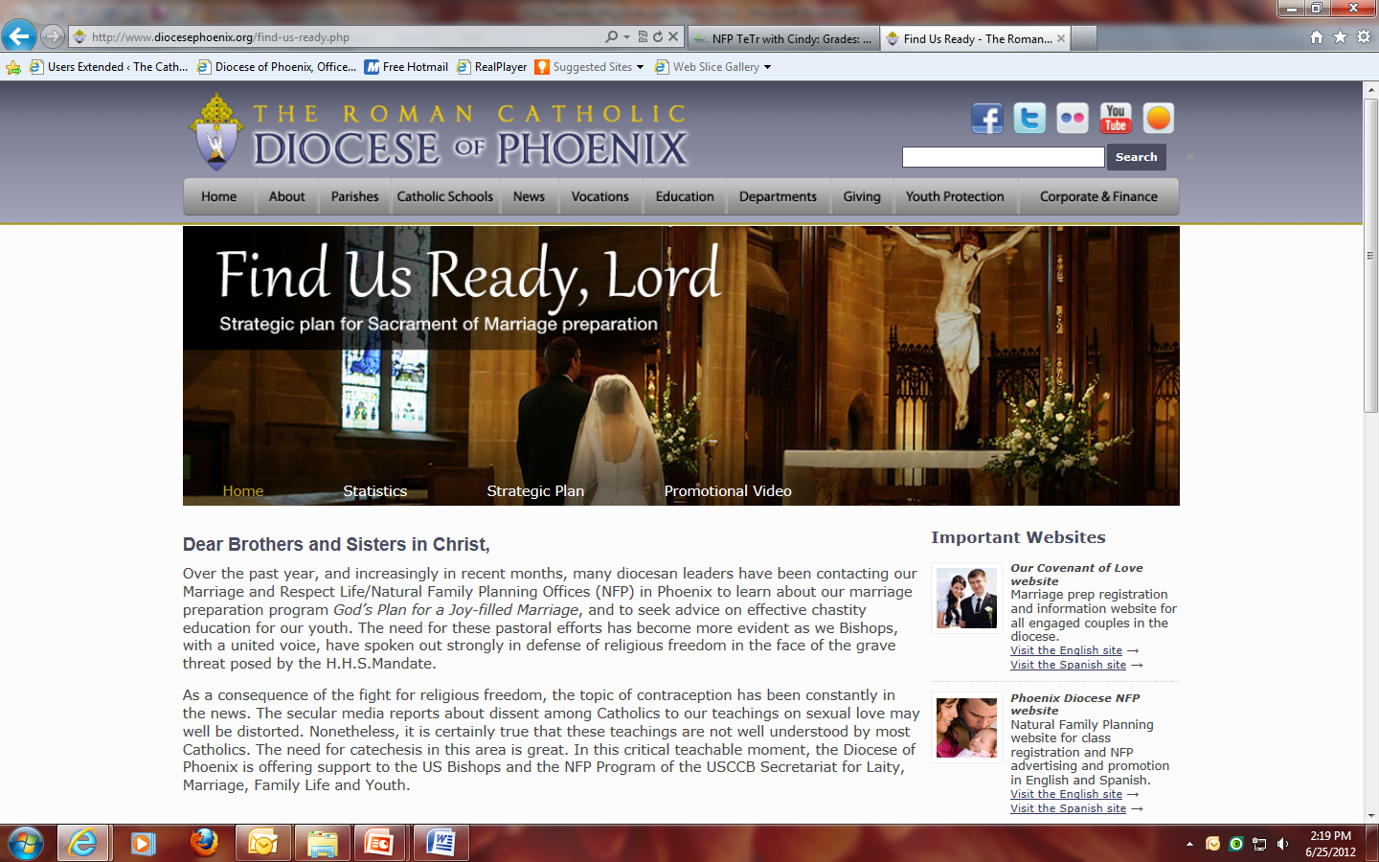
http://www.diocesephoenix.org/find-us-ready.php
Stage 1
Notes:
His Letter was mailed on May 2. Having to put this on a website for anyone to see forced us to clean up some items: The Spanish script for the 2 hour NFP intro’s ppt got an edit, the Parish Rep training received an edit, and the missing Spanish full length video is now being worked on by our Hispanic videographer so we can add that piece very, very soon.
Bishop has already received positive replies from a few fellow bishops (15) and has passed them on to us. Had already sold videos to 15 dioceses previous to this mailing. Now several more have ordered videos, some in very big bulk orders.
One thing that this highlights is how fortunate we all are to be working in this ministry at this time and in this dioceses. Our bishop is a leader among our US bishops and has been incredibly supportive of NFP. And it is also important to point out that NFP promotion and teaching is a critical to healing our culture and is providing real hope for couples. And, because we so fortunate here in Phoenix, we need to share what we have. We probably have one of the largest diocesan group of NFP teachers in the country, maybe the world. We have a lot to be thankful for but it is also time not to be complacent in seeing that there are so many doing this work, maybe we can all take a break. Instead it really is time to seize the day and push forward in promotion of NFP in any place where we can. And, not just to the captive audience of engaged couples.

Slide 8
Stage Two: Launching the NFP requirement strategy- do’s and don’ts
Promotion, education, trainings prior to implementation to prepare for the changes:
Clergy- mailings, workshops, seminars
Marriage Prep Lay Leadership- workshops, seminars, mandatory trainings
Laity- Articles in Diocesan newspaper, NFP Awareness Week announcements, Videos at Mass, etc.
Important to Invest time, money, effort.
Stage 2

Slide 9
Fargo
Bathroom Ad
Stage 2

Slide 10
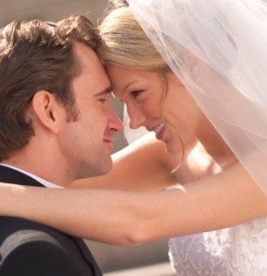
Diocese of Phoenix Marriage Prep Timeline
Jan 1: A couple meets with Pastor or his delegate, parish starts their Nuptial File.
Jan : FOCCUS inventory
Jan-Mar: Married Life Skills Course (weekend or 6 evenings)-ex: Love for Life, Engaged Encounter, Unitas or other approved program.
Mar-June: God’s Plan for Joy Filled Marriage –which includes an NFP Introduction by an NFP teaching or Rep couple.
April- July: Full NFP Course – at least 4 sessions over 10-12 weeks, including charting.
Aug 15—Sept 15: Reconciliation
Aug 1-Sept 1: Final meeting with Pastor or his delegate
October 1st wedding!
Stage 2

Slide 11
diocese of phoenix Multi Layered Approach
Initial Survey for family planning/NFP usage in diocese. May 17 - June 17, 2009. Will repeat Survey in June 2015 after 5 years with new policy.
NFP Couple Parish Representatives
- 1-2 trainings per year
- 34 Parish Rep Couples
Increase Numbers of NFP Instructors: Focus on Recruitment, Training, On-going Formation, Collegiality
-Variety of Methods represented (NWFS, CCL, BOMA, Family of Americas)
- 85 teachers ( most are couples) in English, Spanish, Vietnamese, 2 Chaldean teachers in training.
4. Diocesan NFP Introduction Presentation Enhanced and placed at end of God’s Plan for Joy Filled Marriage Seminar.
Stage 2

Slide 12
diocese of phoenix Multi Layered Approach
5. New Website to promote, register, advertise, & offer refresher and special classes to support clients throughout their reproductive lifetime : www.phxnfp.org
6. On-line Client Instruction
-Paid Half-Time Instructor
-Ability to teach around 300 couples per year
7. NFP Video Project: English and Spanish
8. Outreach to NFP-Only Healthcare Professionals
-Attend Catholic Physician’s Guild Meetings
-Send letters/NFP info to Pro Life Physicians/PRAY for them!
Refer and support:
- 3 NFP Only Ob/Gyns
- 3 NaproTechnology Medical Consultants (DO, PA,
Ob/Gyn)
-2 Family Practice
Stage 2

Slide 13
Stage Three- Reality: How it has worked
-Relaxations of policy
-Necessity of repeating trainings
-Other challenges: language barriers, clients who want to cut corners, teacher recruitment, training, ongoing formation, collaboration with all NFP methods.
Stage 3

Slide 14
Stage four- Results documented among couples, priests
-Compliance Rates
-Continuation Rates
-Acceptance Rates
Stage 4

Slide 15
Diocese of Fargo
NFP Program Statistics
Stage 4

Slide 16
Diocese of Fargo
Question 1
Stage 4

Slide 17
Diocese of Fargo
Question 2
Stage 4

Slide 18
Diocese of Fargo
Question 3
Stage 4

Slide 19
Diocese of Fargo
Question 4
Stage 4

Slide 20
Diocese of Phoenix Client Statistics
2009: Pre- Policy-1234 Couples in Intros &
380 Couples Complete NFP Series
2010: Transition Year-520 Couples in Intros &
653 Complete NFP Series
( 1917 weddings)
2011: 1102 Couples complete NFP Series/1571 weddings
( 70% Compliance)
2012: 1062 Couples complete NFP Series/ no wedding stats yet
2013: 600 Couples complete 1st 6 months ( project 1200)
Stage 4
Notes:
2012 teaching stats: 653 English Couples & 386 Spanish Couples in full series. 20 refugee women and 7 men. Plus what CCL and Morningstar teach- about 50 couples a year.
2013- Jan. 1- May 1, 2013 (4 months)- 268 English Couples & 146 Spanish Couples- looks like this will year will top out around 1200+ for us.
Websites still getting lots of hits- pass out google analytics.
Video Sales-314 to 60 different addresses, all over country.

Slide 21
Diocese of Phoenix-Online NFP Stats
Stage 4
*Stats are taken over the entire life of the course. Some questions were added later so not all couples have answered questions.
2010 -2013

Slide 22
Interest in Course at Beginning
Stage 4
Please select the statement that best describes your interest in NFP:

Slide 23
Intent of Use at Beginning
Stage 4
If you are interested in NFP, please check the statement that best fits your family planning intention:

Slide 24
Contraceptive Use at entry
Stage 4
What form of contraception (if any) are you currently using?

Slide 25
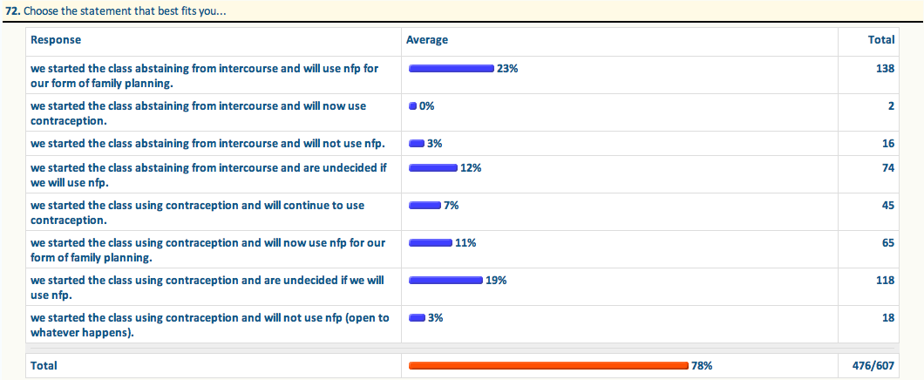
Intent of Use at End: for Nfp-34%** undecided-31%* out of 78% respondents
Stage 4
Notes:
23 + 12= 35% for NFP
12 + 19= 31 Now undecided

Slide 26
Final Intent of Use 61% yes to nfp, 39% say no out of 607 online couples
Stage 4
When only given the option to answer “yes” or “no”…

Slide 27
Phoenix- Client evaluation- part 1
Stage 4

Slide 28
Phoenix- Client evaluation-Part 2
Stage 4

Slide 29
God’s Plan Evaluation Summary for the Diocese of Phoenix 2010-2012
Stage 4
Number of Evaluations: 3,184 Completed

