Slide 1
Marquette University Institute for NFP Evidenced-Based e-Distance Learning
National Association of Catholic Family Life Ministers
Workshop
July 19, 2013

Slide 2
Marquette e-Distance Learning
NFP Online Teacher Training Program (Since 2000)
NFP Online NFP Couple Training (Since 2008)
NFP Annual Summit Meetings and Staff Conferences 2012, 2013

Slide 3
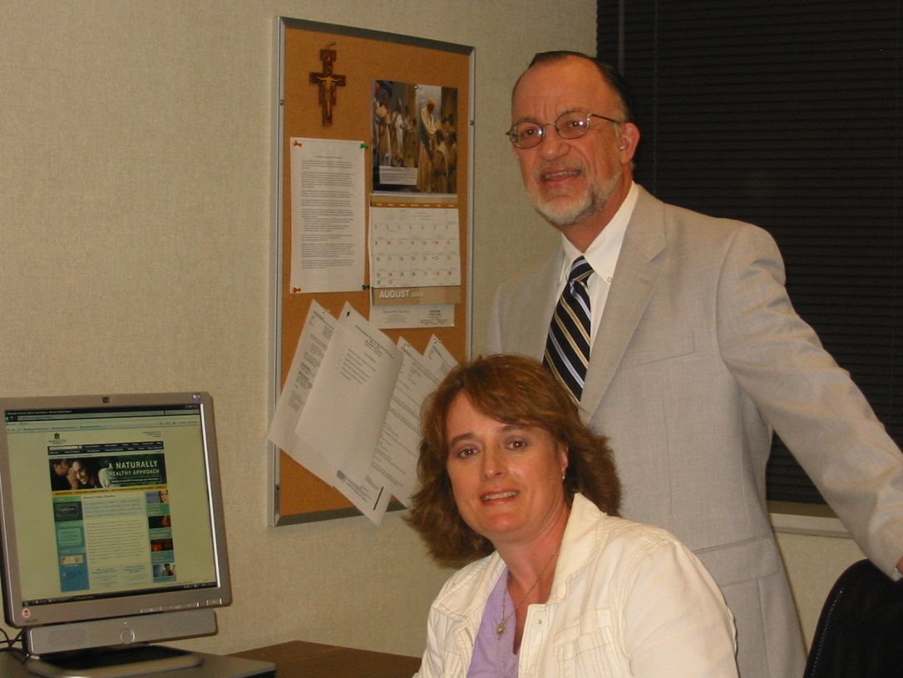
Online NFP Teacher Training

Slide 4
NFP Teacher Training
3 Credit NFP Theory Course – 12 Modules
3 Credit NFP Practice Course – 12 Modules
Only for Health Professionals

Slide 5
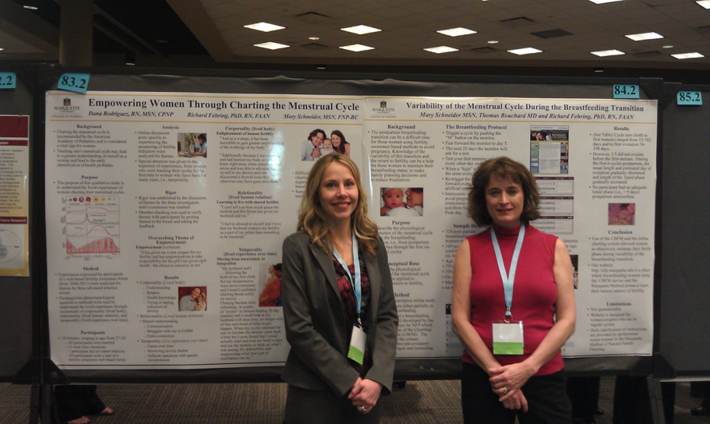
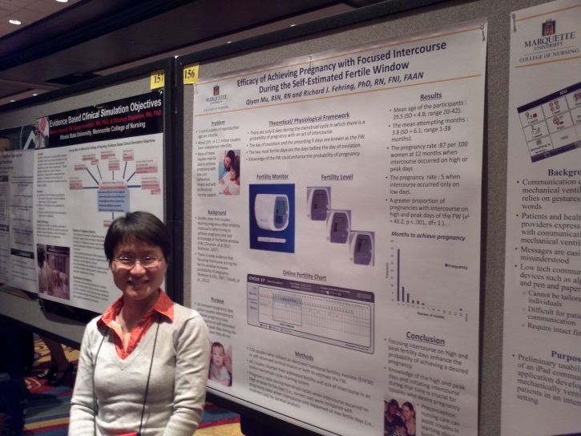
Marquette NFP Teacher Training
NFP Theory
NFP Practice Course
https://d2l.mu.edu/
https://d2l.mu.edu/

Slide 6
New Approach: Self-paced
NFP Core Theory
NFP Practice
NFP Med Application

Slide 7
Module Format
Readings from E-Reader
Readings from Evidenced Based articles and protocols
Powerpoint presentations
Required discussion
Large and small assignments with rubrics (e.g., NFP brochure or flyer for their NFP program).
10-20 point quizes with 90% passing rate

Slide 8
Core Course Modules
Core course modules:
Module 1: Introduction and History of NFP and basic review of reproductive anatomy and physiology
Module 2: Scientific Foundations of NFP
Module 3: Management of Women's Health Issues through Charting (6hrs)
Module 4: Identification and Management of Special Circumstances.
Module 5: Psychological, Spiritual and Behavioral Ethical Issues
Module 6: Marriage and Family Life

Slide 9
Teacher Training Modules
Module 1: Teaching NFP and the Marquette Method.
Module 2: Introduction to charting and interpretation.
Module 3: Program development, marketing and management (6hrs).
Module 4: Professional principles of a Fertility Health Educator.

Slide 10
Medical Applications Modules
Module 1: The Menstrual Cycle and Women’s Health
Module 2: Application of NFP to sub-fertility and infertility management
Module 3: Application of NFP to PCOS management
Module 4: Application of NFP to managing dysfunctional uterine bleeding
Module 5: Application of NFP to common women’s health problems

Slide 11
Evidence Based NFP e-Couple Training
Fehring, R, Schneider, M, & Raviele, K. (2011). Pilot Evaluation of an Internet-based NaturalFamily Planning Education and Service Program, Journal of Obstetrics, Gynecology, and Neonatal Nursing. 40(3):281-91.
Fehring, R., Schneider, M., Raviele, K, & Rodriguez, D. (2013) Randomized Comparison of Two Internet-Supported Fertility Awareness Based Methods of Family Planning, Contraception, 2012. 88: 24-30.
Fehring, Schneider, Raviele, Barron. (2013). Influence of motivation on the efficacy of NFP. The American Journal of Maternal Child Nursing, Accepted 4/2013>
Bouchard, T, Schneider, M & Fehring, R. (2013). Efficacy of a new postpartum transition protocol for avoiding pregnancy. Journal of the American Board of Family Medicine. 26, 35-44.
Mu, Q., and Fehring, R. (2013). Efficacy of Achieving Pregnancy, MCN. The American Journal of Maternal Child Nursing. Accepted 5/2013.
Lasquety, M.G., Rodriguez, D., & Fehring, R. (2012). The Influence of BMI Levels on Phases of the Menstrual Cycle and Presumed Ovulation, The Linacre Quarterly, 79(4).

Slide 12
Notes:
. The charting system will also notify the user of possible health problems, like unusual bleeding, infertility, and cycle dynamics that are out of the norm. However, none of these systems have been studied for their efficacy and ease of use – furthermore, their efficacy will only be as good as the NFP method that they provide.
12

Slide 13
Marquette Online FA/NFP
Quick-start instructions
Information on monitoring fertility and special circumstances
Online charting and interpretation
Online discussion rooms
Online consultation with nurse; physician; bio-ethicist
http://nfp.marquette.edu
Notes:
At Marquette University we recently received grant from the Our Sunday Visitor Institute to develop an online system to provide NFP services – i.e., to teach couples to use NFP. Over the past 5 years we have discovered that couples are reluctant to come to a on site setting for in-person NFP services and often do not show up for appointments. Furthermore, we receive e-mail requests to learn NFP over the e-mail system on a weekly basis. An online service system for NFP is efficient in being able to reach people around the world.
The Marquette online NFP services are in development. We currently have a web portal – as shown in this slide – and hope to have a prototype for testing by January 1st. The proposed web site will have free information on NFP, downloadable charting systems, and a short video clip on how to use NFP. For those couples who register on the site they will be able to use our electronic charting system, access discussion rooms, and have consultation from professional nurse NFP teachers, a NFP only physician, and a Catholic moral theologian.
13

Slide 16
The Web Site and Fertility Chart
Marquette NFP Web Site
Example Breastfeeding Chart

Slide 17
Unintended Pregnancy
I was using _________ on that day I thought it was my basic infertile pattern which now I know it was not. I am just really upset that I didn't know about the Marquette method earlier due to having a child just turning 2 another one 10 months.

Slide 18
Online Forums & Consultation
Notes:
We also have user forums were the user can contact a professional nurse either through the forums or by special messages.
Professional nurse,
Ob/Gyn
Bioethicist
Many respondants indicate that they learn from the questions and answers provided from other women.
We receive from 4-10 questions a day (some very complicated) and answer each within 24 hours or less.
We actually have a duplicate of this Web site for a Federally funded study.

Slide 19
Actual Site
http://nfp.marquette.edu
http://www.youtube.com/watch?v=qj5k90OnbFg

Slide 20
Efficacy Results for Online Learning
Marquette Model II (In-Person and Online)
Monitor plus algorithm:
Correct Use: 99-100% Typical Use: 90-93%
Mucus plus algorithm:
Correct use: 98% Typical Use: 80-84%
Breast Feeding: Fertility Monitor Plus Protocol
Correct Use (12 months): 98% Typical Use: 92%
Achieving Pregnancy: (Fertility Monitor and/or Cervical Mucus)
Correct use: 87% Incorrect Use: 5%
Perimenopause: (Fertility Monitor and/or Cervical Mucus)
Correct use: 98.5% Typical Use: 97%

Slide 21
Qualitative Study
4,000 plus women in online program
Over 10,000 responses in discussion forums
Our lived experience
Spiritual responses,
Spiritual problems, and
Spiritual interventions – i.e., relationship, ethical, spiritual well-being, mystery.
Notes:
We also have user forums were the user can contact a professional nurse either through the forums or by special messages.
Professional nurse,
Ob/Gyn
Bioethicist
Many respondants indicate that they learn from the questions and answers provided from other women.
We receive from 4-10 questions a day (some very complicated) and answer each within 24 hours or less.
We actually have a duplicate of this Web site for a Federally funded study.

Slide 22
Forum Posts > 10,000 Posts; Topics 1500 topics; N = 4,500
Unusual Bleeding
Breastfeeding
Irregular Cycles
Menstrual cramping
PCOS
Monitor questions
Medications & fertility
Infertility
Vaginal infections
Travel effects

Slide 23
Qualitative Comments
I just want to say, I LOVE THIS SITE!! It has helped my husband and I so very much. I appreciate having someone to go to when I have questions. I appreciate the objectiveness that the monitor gives me. I really appreciate having the support of others who do not think I am crazy for choosing a natural way of limiting my family (for the time being) after just having our 5th child. I am not Catholic, but I am very thankful for the belief that we share concerning life. THANK YOU!!
Dr., you just made soda come out my nose!! I will have to remember that quote about NFP not meaning "Not For Protestants"!!

Slide 24
Qualitative Comments:
I just wanted to drop in and say thank you so much!!! The Marquette model has been such a blessing. I am currently tandem nursing (and have either been pregnant and/or nursing since 2005) and my mucus is very difficult for me to discern and chart with accuracy. At this point we have a medical reason that makes postponing another pregnancy very important. The Marquette model has given us comfort and confidence and the on-line charting tool makes it very user friendly for this sleep deprived mama. The forums are also a wonderful resource. Each time I’m about to post a question, I run across another user who has already asked. I have one quick question. I’m just curious what the “federal study site” is. Am I missing something that I should be doing? Once again, THANK YOU!"

Slide 25
Security Issues
Computer viruses
Computer worms
Trojan Horses
Computer Spam
Hackers
Password security
Firewall
Hardware Security
Hosting servers!!
HIPPA
FIRPA

Slide 26
Web Site Down
Dear Mr. Richard Fehring, You receive an important notice regarding your 1&1 Server. Your 1&1 Server was found to be part of a network of compromised machines leading a Distributed Denial-of-Service Attack (DDoS Attack) against other servers. ******************************************************************************* IMPORTANT: In order to prevent further criminal activity from your 1&1 Server, we have suspended access pending an investigation and resolution. ******************************************************************************* Please follow the indications below according to the category of your server to reestablish the access of your 1&1 Server.

Slide 27
Malware – access portals
You will find details about the attack here: PROCESSES: ================== CTID USER PID %CPU %MEM VSZ RSS TTY STAT START TIME COMMAND 47336140 root 3011 0.0 0.0 4888 644 ? Ss May16 00:00:20 init [3] 47336140 root 3019 0.0 0.0 0 0 ? S May16 00:00:00 [kthreadd/473361] 47336140 root 3020 0.0 0.0 0 0 ? S May16 00:00:00 [khelper/4733614] 47336140 root 5680 0.0 0.0 3744 584 ? Ss May16 00:00:17 syslogd -m 0 47336140 named 6719 0.0 0.0 51336 2680 ? Ssl May16 00:07:37 /usr/sbin/named -u named -n1 -c /etc/named.conf -u named -t /var/named/run-root 47336140 root 6879 0.0 0.0 23088 1240 ? Ss May16 00:00:20 /usr/sbin/sshd 47336140 root 7638 0.0 0.0 6512 1204 ? S May16 00:00:00 /bin/sh /usr/bin/mysqld_safe --defaults-file=/etc/my.cnf --pid-file=/var/run/mysqld/mysqld.pid 47336140 mysql 7925 2.1 0.2 172388 44432 ? Sl May16 14:11:22 /usr/libexec/mysqld --defaults-file=/etc/my.cnf --basedir=/usr --datadir=/var/lib/mysql --user=mysql --pid-file=/var/run/mysqld/mysqld.pid --skip-locking --port=3306 --socket=/var/lib/mysql/mysql.sock 47336140 qmails 9121 0.0 0.0 2704 508 ? S May16 00:00:05 qmail-send 47336140 qmaill 9124 0.0 0.0 2652 508 ? S May16 00:00:00 splogger qmail 47336140 root 9125 0.0 0.0 2692 392 ? S May16 00:00:00 qmail-lspawn ./Maildir/ 47336140 qmailr 9126 0.0 0.0 2824 680 ? S May16 00:00:00 qmail-rspawn 47336140 qmailq 9127 0.0 0.0 2648 388 ? S May16 00:00:00 qmail-clean 47336140 root 10957 0.0 0.1 171016 22896 ? Ss May16 00:01:08 /usr/sbin/httpd 47336140 root 12501 0.0 0.0 92392 5876 ? Ss May16 00:00:41 /usr/local/psa/admin/bin/httpsd

Slide 28
Online Conferences

Slide 29
New Fertility Monitoring Systems
Apple Store
Or How to Finance Your Research$$$

Slide 30
NFP Web/App Team

Slide 31
muFertility: App Screenshots

Slide 32
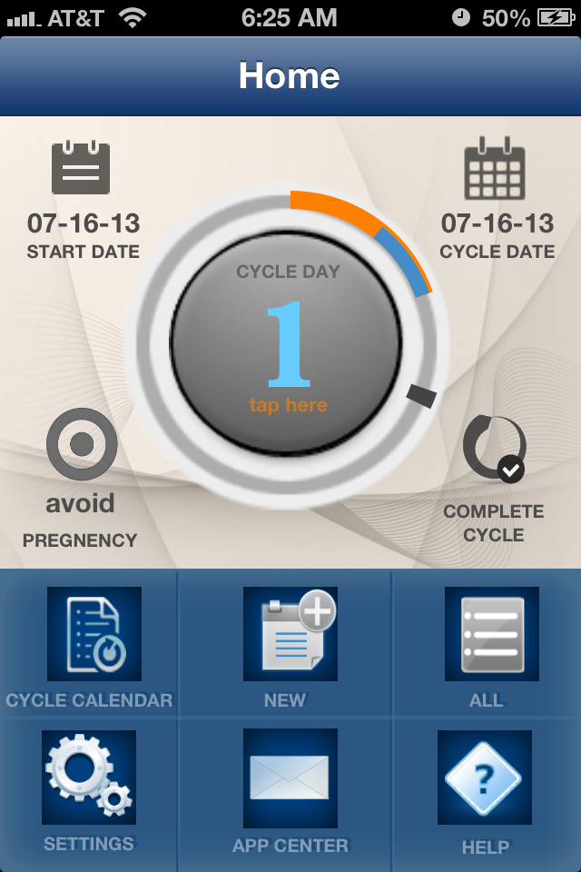
Home Screen

Slide 33
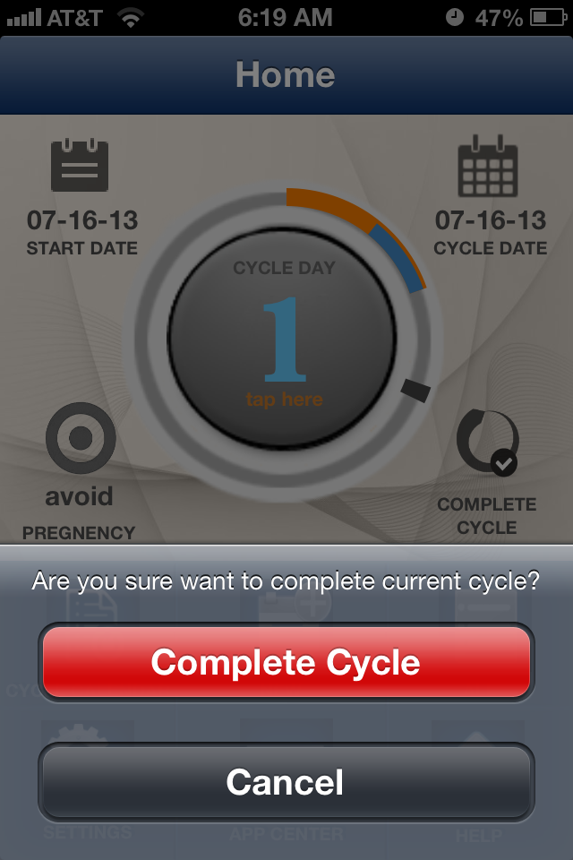
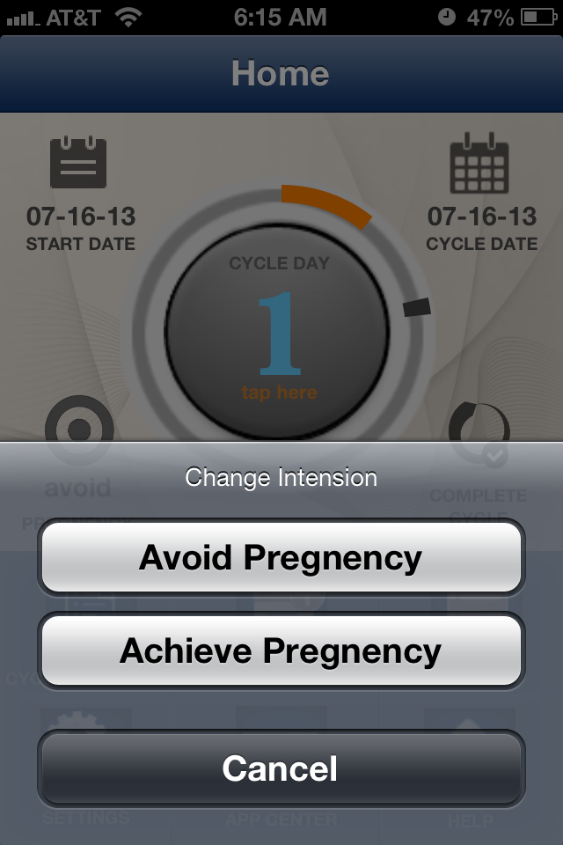
Complete Cycle & Intension

Slide 34
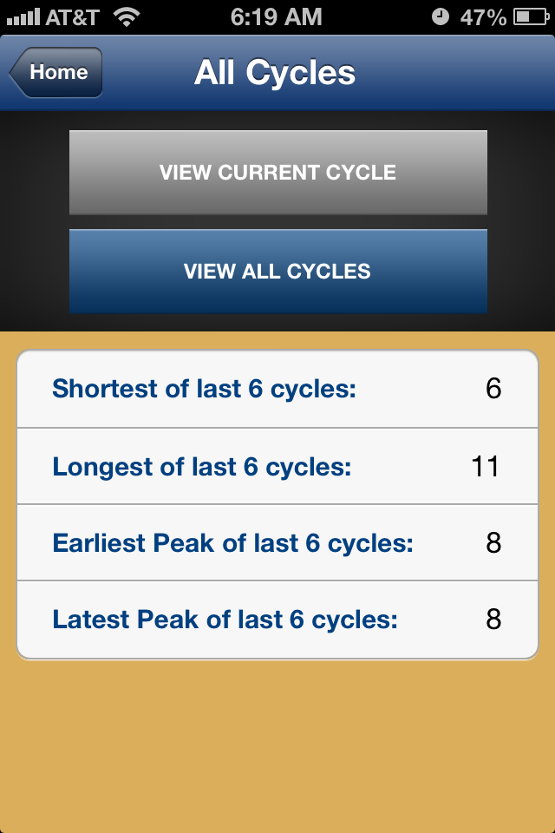
All Cycles

Slide 35
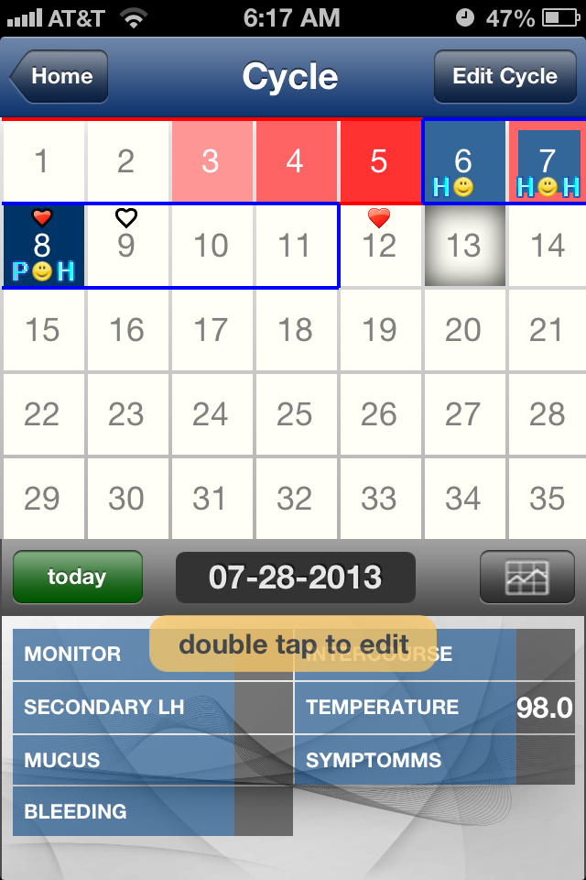
Calendar

Slide 36
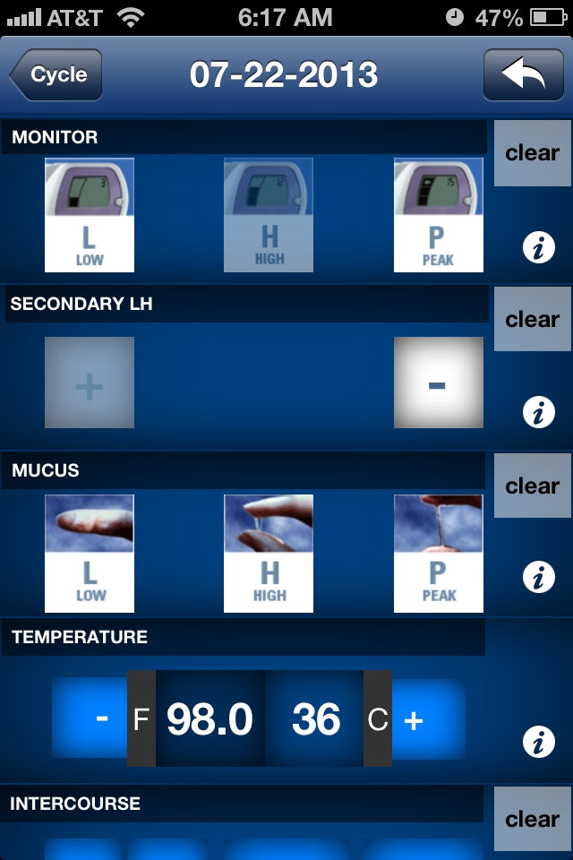
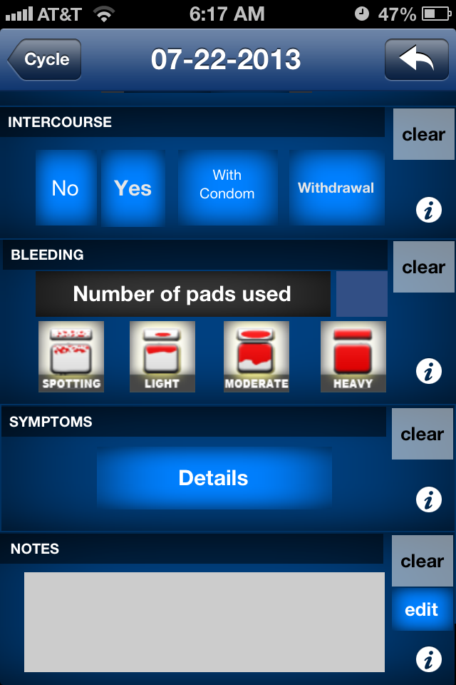
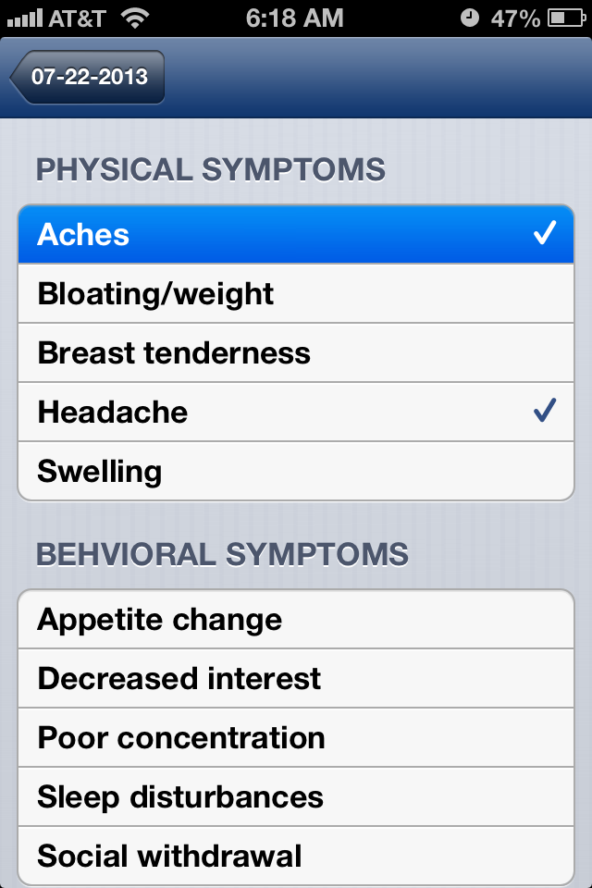
Data Entry Screen

Slide 37
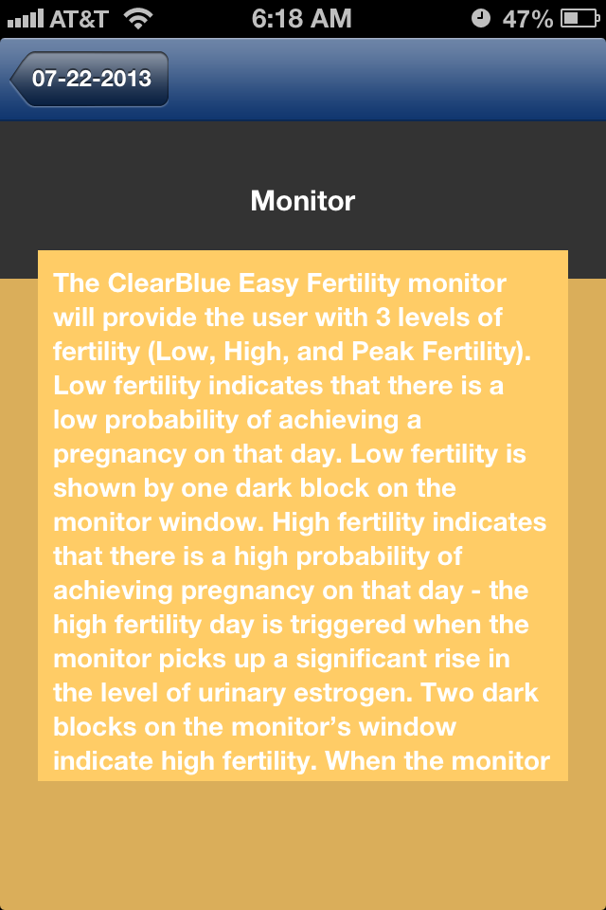
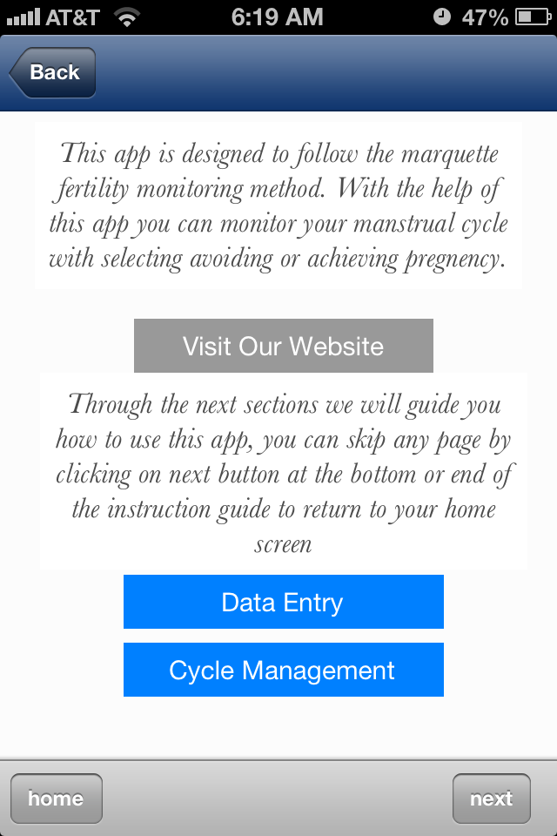
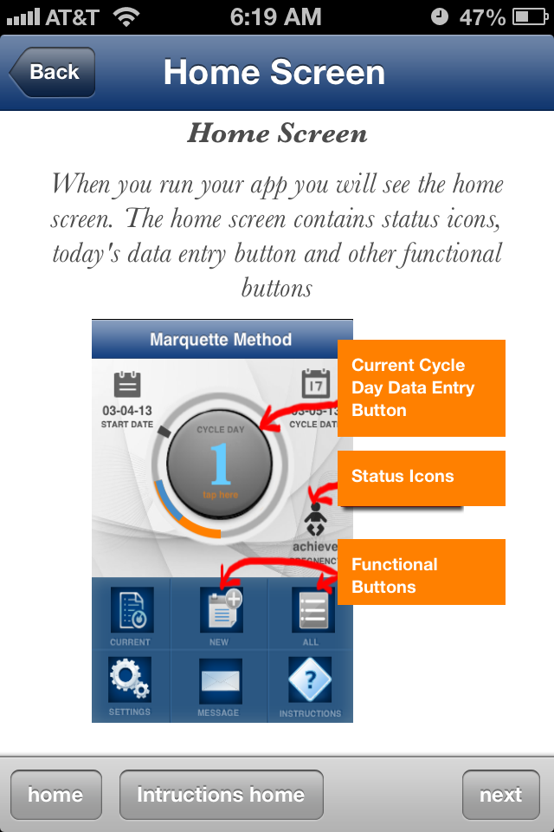
Help Pages

Slide 38
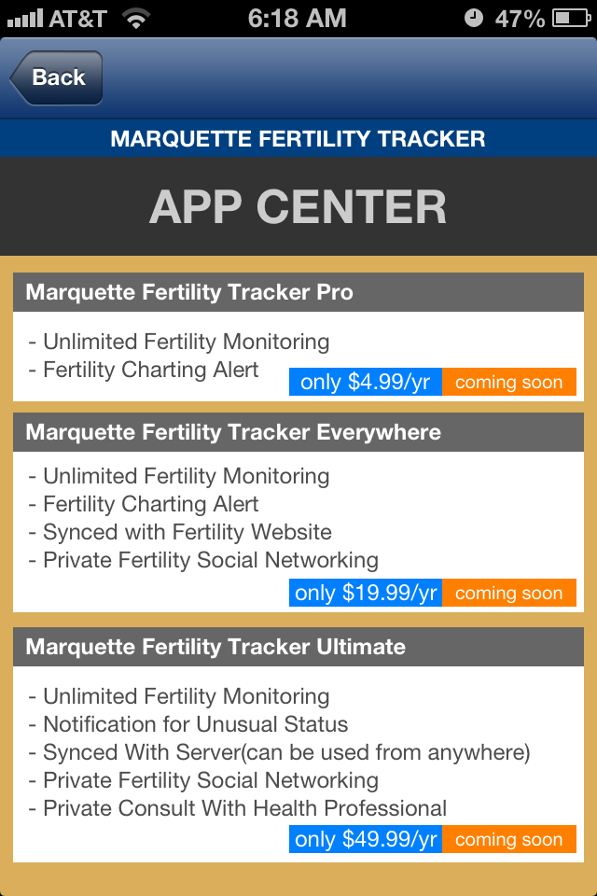
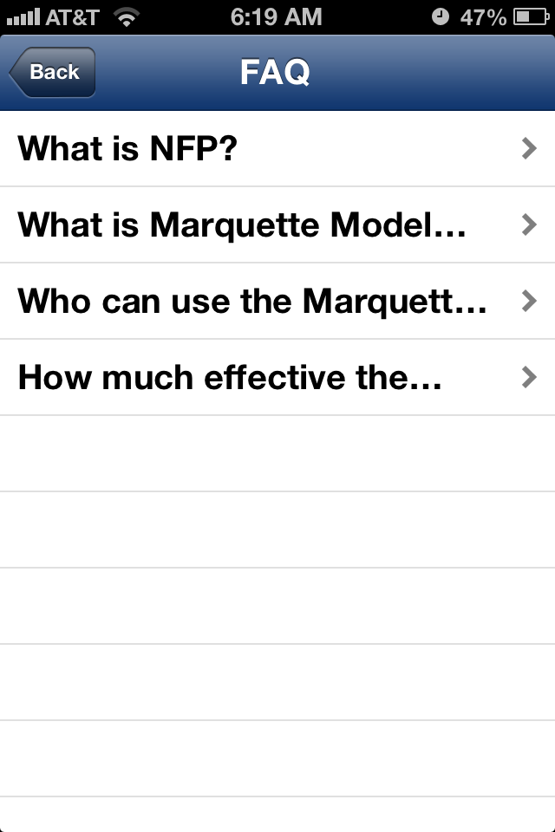
Upcoming Apps & FAQ

Slide 39
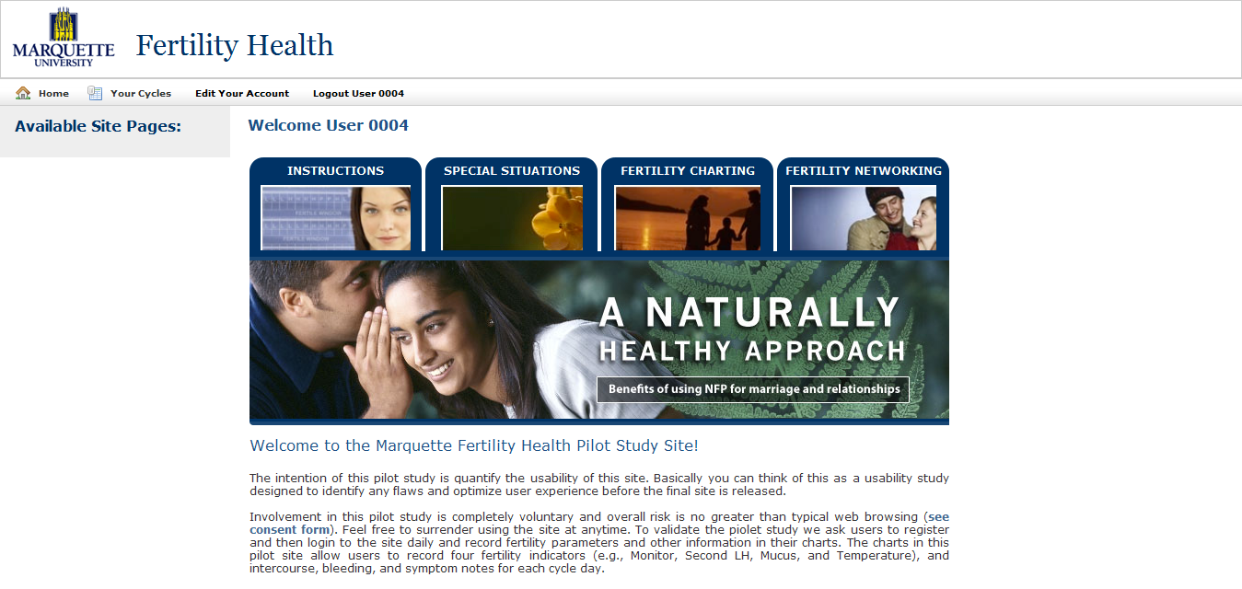
Cycle monitoring website

Slide 40
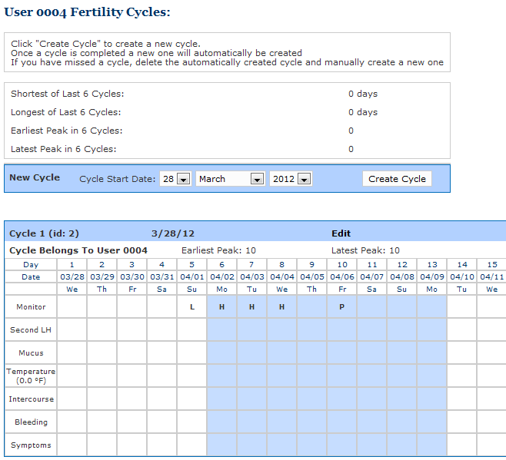
Cycle monitoring website

Slide 41
Qualitative Feedback
Thank you very much for responding Dr. Fehring! This website and message board has been by far the most helpful and straightforward online resource for NFP! I truely appreciate the access to all of the information and charting tools.

